Slide 1
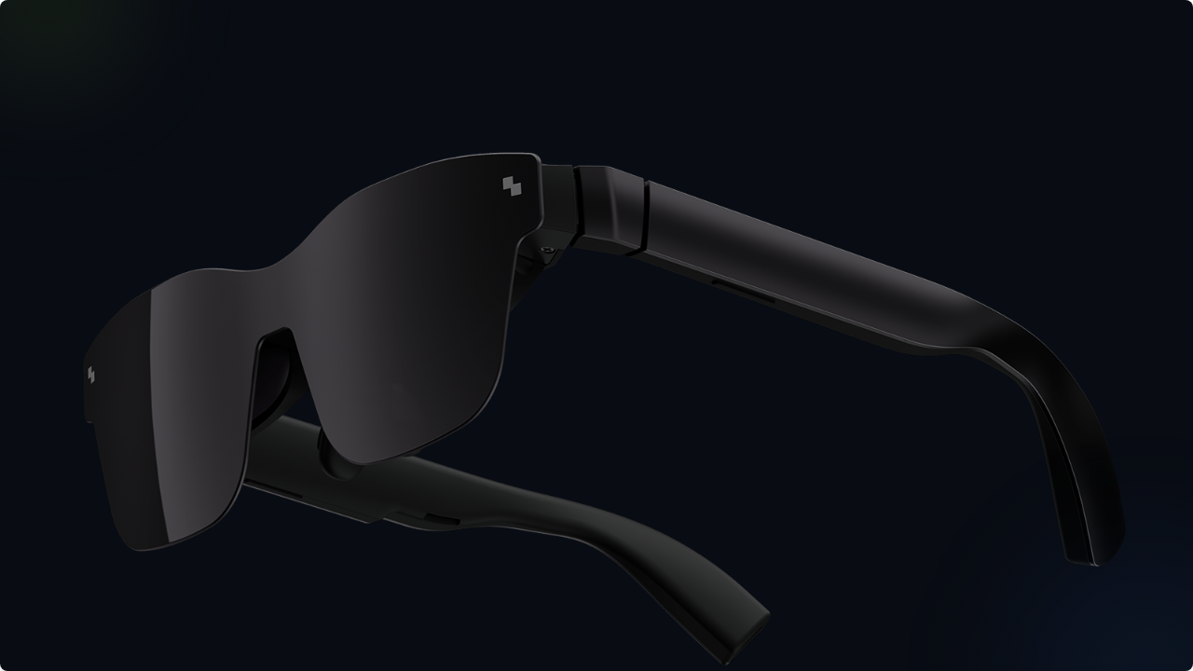

RayNeo AR Glasses
Digital Communication Strategy
MAR410 Project F2025
Group members: Grayson Eric Cecilia Judy Chavin V Rin Jocelyn

Slide 2

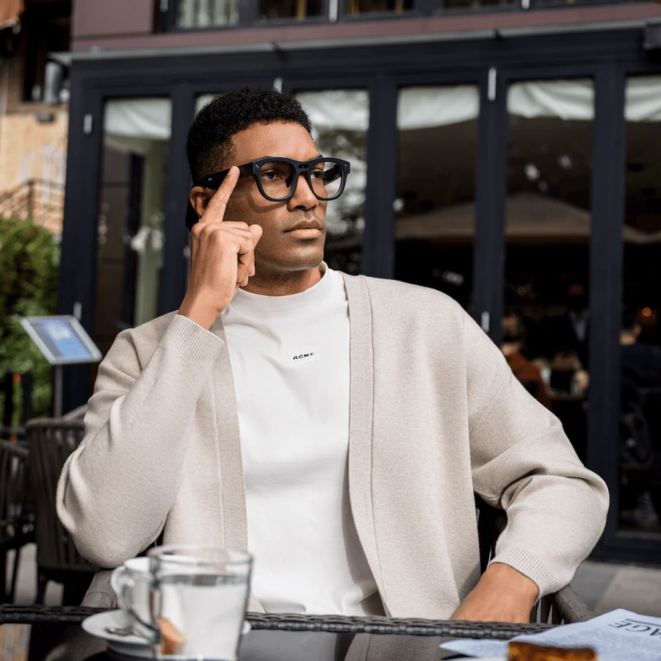
Brand & Product Introduction
Brand: RayNeo
As an innovative brand under TCL, RayNeo has rapidly emerged as a leader in consumer AR since 2021, leveraging TCL's deep expertise in display technology and supply chain.
Product: RayNeo X2
The flagship "True AR" glasses. It features a cutting-edge "diffraction light waveguide + MicroLED" solution and is powered by the Qualcomm Snapdragon XR2 chip.
It seamlessly integrates digital information with the physical world, covering diverse scenarios like translation, navigation, AI companionship, and remote work.

Slide 3





Vision, Mission & Objectives
Vision
Mission
Objectives
Seamless integration of digital information and the physical world to enhance work efficiency and life enjoyment through continuous tech innovation.
To become a 'bridge connecting the virtual and the real', making AR glasses a 'next-generation smart device' accessible to all.
Achieve tech leadership (12-18mo leaps), global market penetration (Top 3 in 3 yrs), and build a robust AR ecosystem.

Slide 4


Market Strategy: STP Analysis
Segmentation
Targeting
Positioning
Young Professionals, Students, Tech Enthusiasts, and Cross-border Travelers.
Core focus on Young Professionals & Tech Enthusiasts. Radiate to students & travelers.
"Lightweight, All-Scenario AI AR Companion." Positioned as an essential tool, not just a novelty toy.

Slide 5
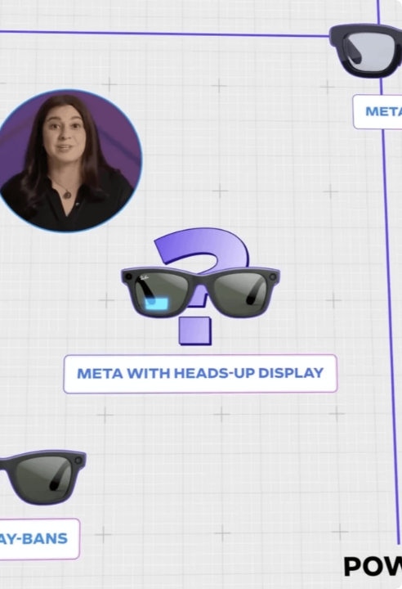
Value Proposition
Efficiency Boost : Multi-screen work, real-time translation, and meeting minutes free your hands.
Experience Innovation : 1500nits peak brightness and lightweight design for a comfortable, clear display.
Cost Optimization : Flagship core configuration at an entry-level price, providing a "one-machine, multi-use" value.
Social/Trend Value : "Supercar" waistline design and detachable lenses make it a fashion statement.

Slide 6


Digital Environment: SWOT Analysis
Strengths
Opportunities
Core tech (MicroLED, XR2) is easy to demonstrate. Target audience is digitally native and active on social media.
Tech platforms (TikTok, Bilibili) support new hardware. "Seeding economy" (KOL/KOC) is strong for tech products.
Weaknesses
Threats
High cognitive barrier for AR concepts. Core experience (comfort, visuals) is difficult to convey online.
Homogenized competition in digital channels. Negative sentiment spreads fast. Rising vertical traffic costs.

Slide 7

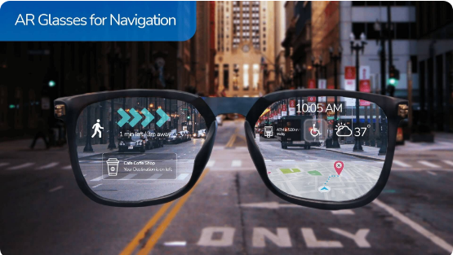
Digital Strategy
1. Content Marketing
Layered Education: "1-min AR" videos for novices; deep-dives for tech enthusiasts.
Scenario Stories: Vlogs (travel, work) showing 1st-person use of navigation, translation, etc.
2. Social Media
•
Douyin/TikTok: Quick, impactful demos (e.g., "3-second translation").
•
Bilibili: In-depth reviews & tech analysis with major UP creators.
•
Red Notes: "Fashion + Utility" focus with lifestyle and travel bloggers.
•
Zhihu: Expert Q&A to build product authority.

Slide 8



Digital Strategy
3. Paid Ads
4. Community
5. SEO
Target interest labels (tech, travel) on social. Bid on search ads for "best AR glasses" & "mobile office tool".
Build private domain groups with tech experts. Offer exclusive coupons & referral rewards to drive loyalty.
Optimize for core keywords ("RayNeo AR") and long-tail Qs ("how to choose AR glasses") on web and e-commerce.

Slide 9
Privacy & Security Strategy
Data Control: Follow "Minimum Necessary" principle, with visual consent and dynamic, anonymized profiling.
Full-Lifecycle Security: End-to-end encryption for data in transit and at rest. Hierarchical access control.
Technology-Powered Privacy: Use Edge Computing for on-device processing (SLAM, face ID) to reduce data upload risk.
Legal & Ethical: Strictly comply with PIPL & Data Security Law. Conduct third-party audits and provide clear user rights channels.

Slide 10


Data-Driven Closed-Loop Evaluation
1. Brand & Reputation
4. User Loyalty
KPIs: Site traffic, social follower growth, media mentions.
KPIs: Net Promoter Score (NPS), repeat purchase, UGC quantity.
2. User Engagement
5. Product Iteration
KPIs: Interaction rate, video completion, community activity.
KPIs: Feature usage rate, fault feedback, update adoption.
3. Conversion & Sales
6. The Loop
KPIs: CTR, CVR, sales volume, CAC.
Use this data to: Evaluate -> Optimize -> Implement -> Re-evaluate.

Slide 11


Summary
Strategy
Execution
Deploy layered content across diverse social platforms (Douyin, Bilibili, RedNote) to educate and inspire.
Anchor in tech leadership, targeting key personas (professionals, tech lovers) to build an "all-scenario companion" brand.
Build trust via transparent, tech-powered privacy (Edge Computing) and active community management.
Core message: Use differentiated "Tech + Scene" content to show, not just tell.
Use a data-driven closed-loop to continuously optimize strategy and product.

Slide 12
THANK YOU FOR LISTENING!
RayNeo AR Glasses
Digital Communication Strategy
MAR410 Project F2025
Group members: Grayson Eric Cecilia Judy Chavin V Rin Jocelyn

